Slide 2
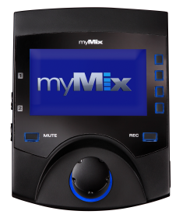
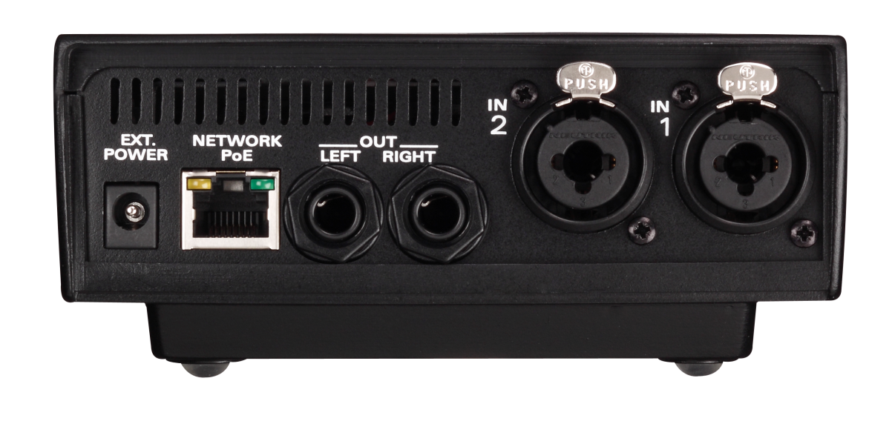
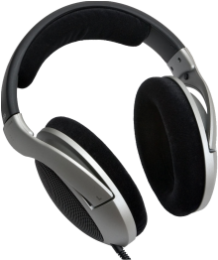
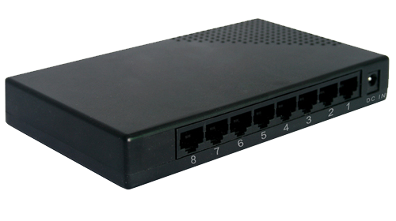
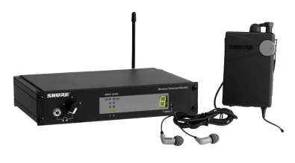
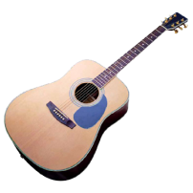
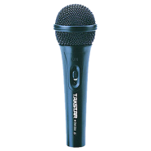
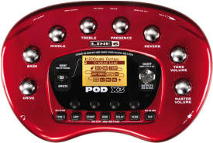
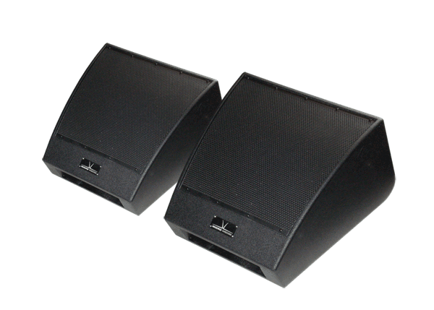
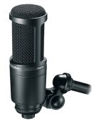
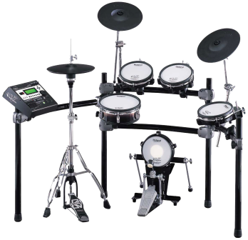
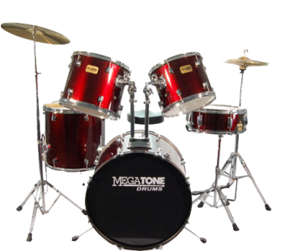
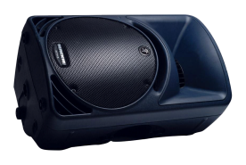
or…
or
or
or
or…
or
or
or
or…
Notes:
Typical inputs and outputs

Slide 3
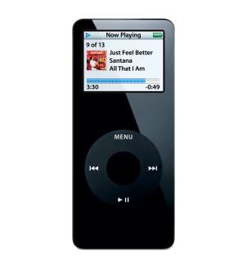
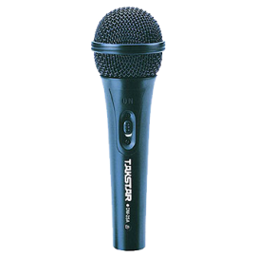
Notes:
Example using one myMix as FOH with talkback mic and MP3 player music source for in-between sets

Slide 4
or
FOH console
or
Stage Box
Notes:
Example using Y-cable

Slide 5
or
FOH console
or
Stage Box with Split
Notes:
Example multi-mic drumkit using stage split pulling just kick and snare into drummer’s myMix

Slide 6
Stereo drum submix
or
FOH console
or
Return
Stage Box with Split
Notes:
Example multi-mic drumkit using stage split with FOH gated, compressed, EQ’d stereo submix to drummer’s myMix

